Slide 1
MATUL Presentation
Amanda Sanchez, Ph.D.
Executive Director
CaCHE Global

Slide 2

Shared Vision
CaCHE is a vision to disciple the nations by offering church-based, community-centered higher education programs.

Slide 3
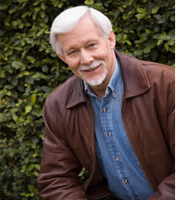
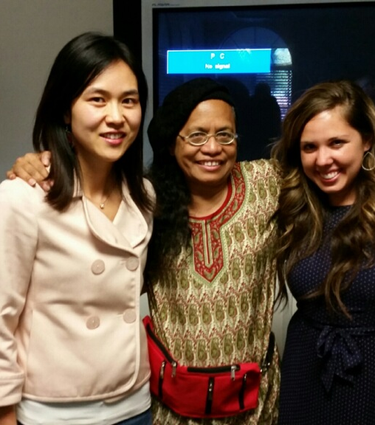
Who We Are

Slide 4

CaCHE Explained…
Church-based: We seek to work through local churches, or an institution that has church support behind it.
Community-centered: Our programs focus on equipping students to be servant leaders in their local communities through sacrificial volunteer service; we also want our programs to draw upon local expertise and learning opportunities provided through internships.
Higher education: Our programs leverage a variety of high-quality online content to give students a wholistic post-secondary education that focuses on Christian worldview, liberal arts, and professional studies.

Slide 5
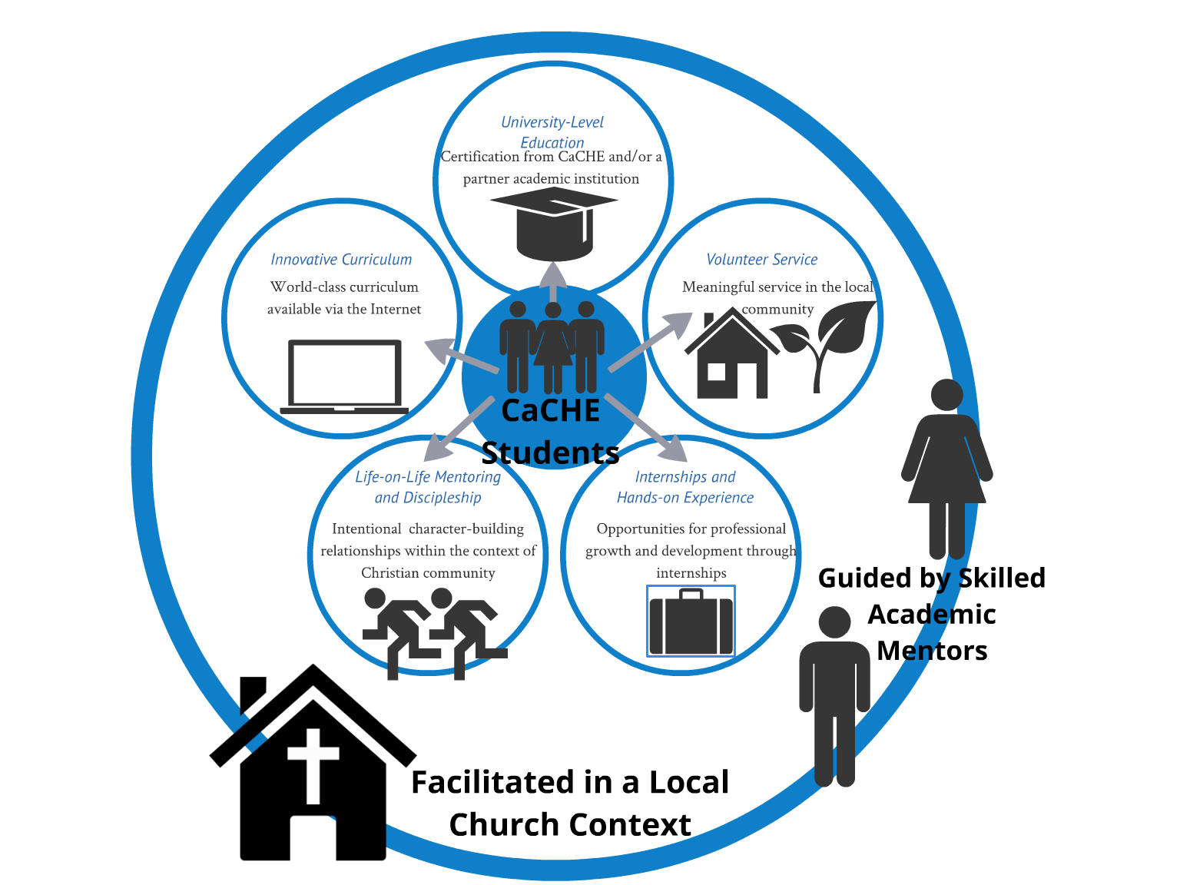

Slide 6

The Pieces of CaCHE Explained…
Facilitated in a local church context
Guided by skilled Academic Mentors
Innovative curriculum
University-level education
Volunteer community service
Internships and hands-on experience
Life-on-life discipleship and mentoring

Slide 7
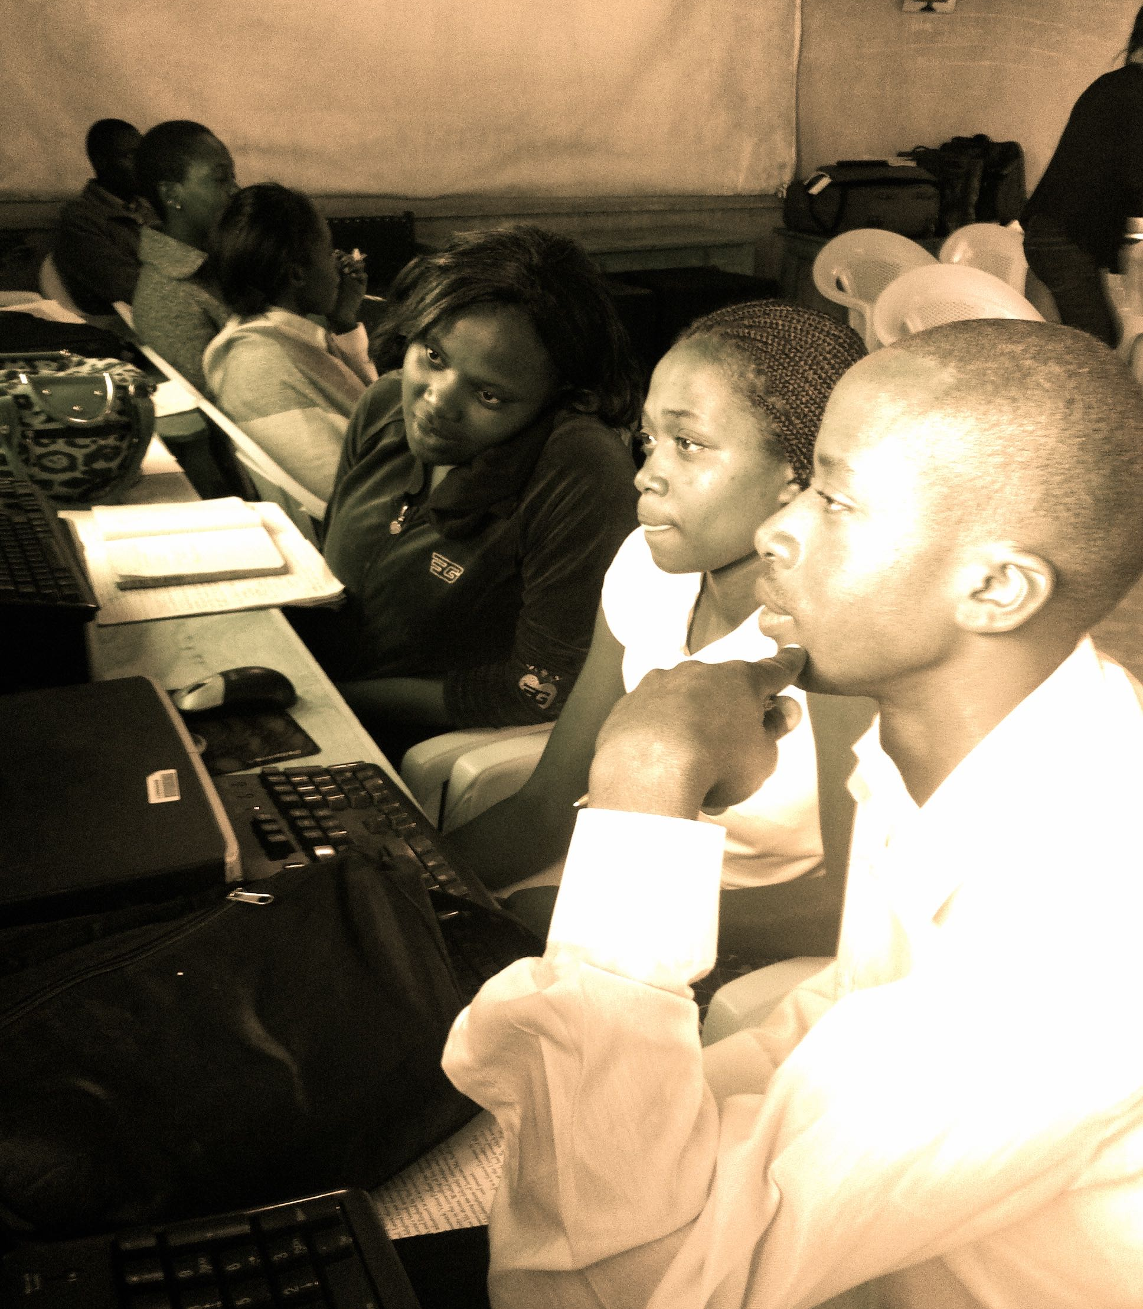
CaCHE in Practice…
Two CaCHE programs started in slum areas of Nariobi, Kenya
Five Academic Mentors trained for each site
Two diploma programs offered in Software Development or Business/Entrepreneurship
First semester consists of a “Foundation Semester” that provides an introduction to digital literacy, Christian worldview, and English writing
Working on building bridges for future student internships

Slide 8

PROCESS
Relationship – Academic Mentors
Reflection – Socratic Dialogue
Contextualization – Curriculum and Community-Based Experiences

Slide 9


Slide 10
Academic Mentor Training
Orientation
Online Course
Onsite Practicum
Ongoing Professional Development

Slide 11
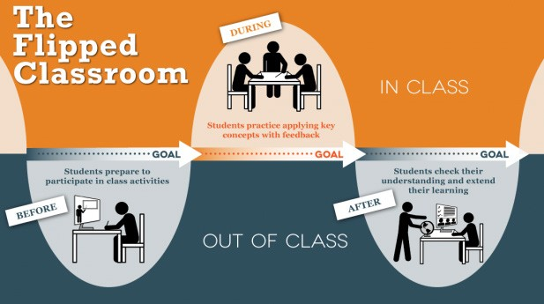
Reflection
OverView
WorldView
MyView
ReView
(© image source: http://ctl.utexas.edu/teaching/flipping-a-class/what)

Slide 12
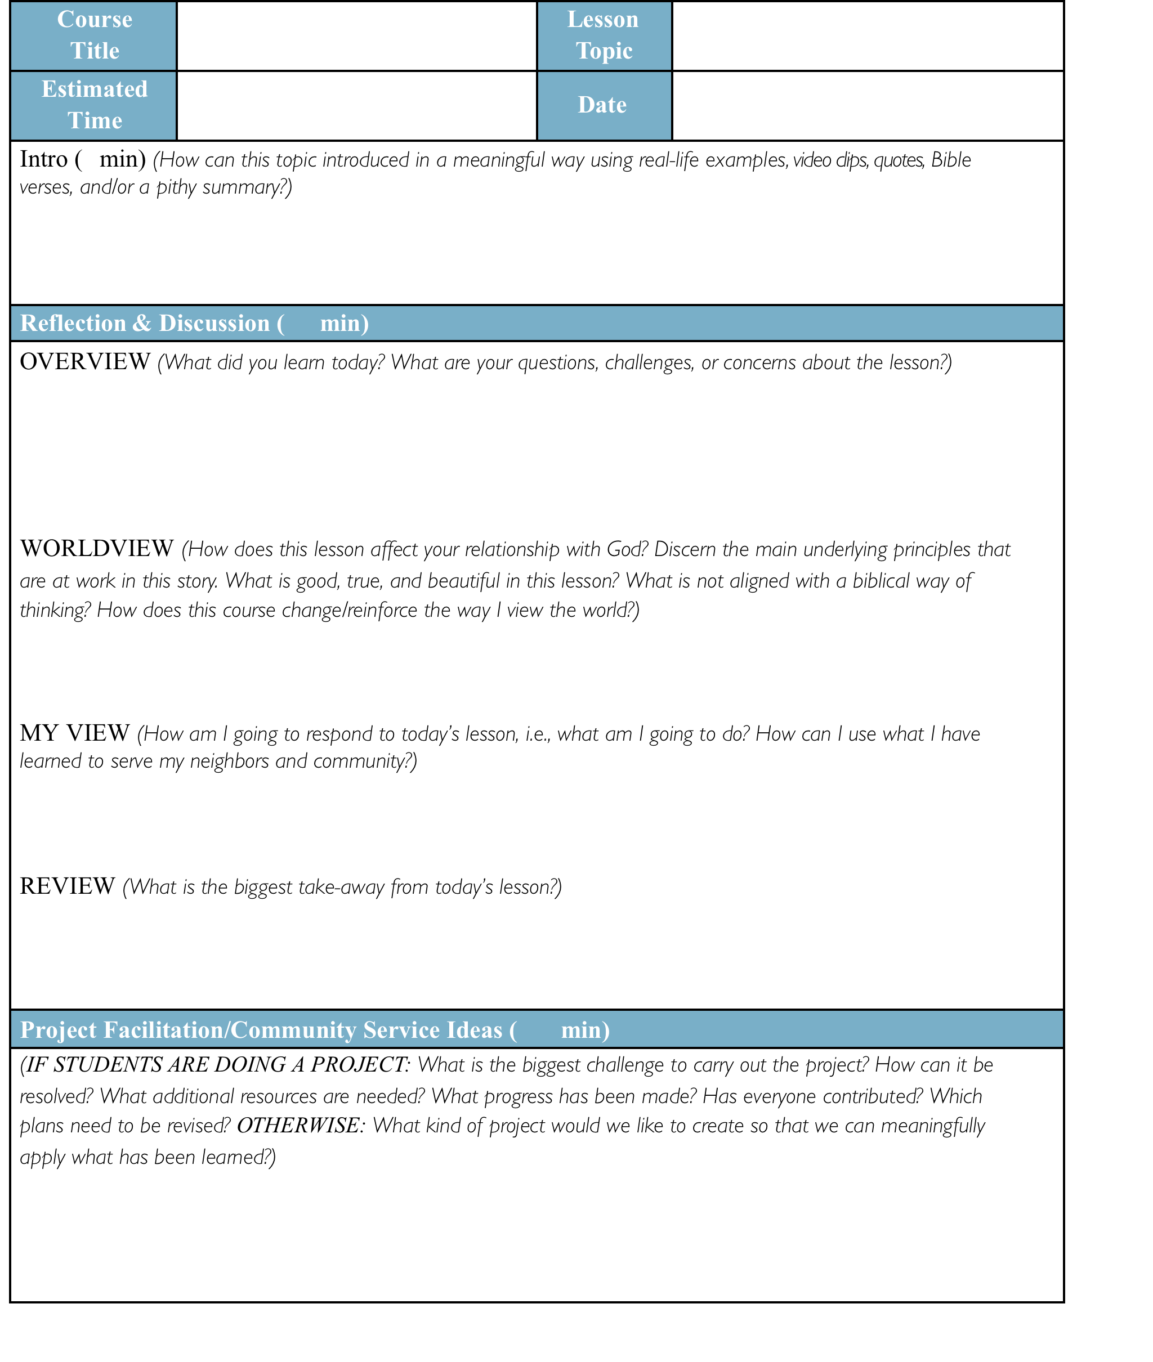

Slide 13
Contextualization
Internship Connections
Service Learning Seed Projects
Curriculum Design
  4C Learning Framework
  Curriculum Framework

Slide 14
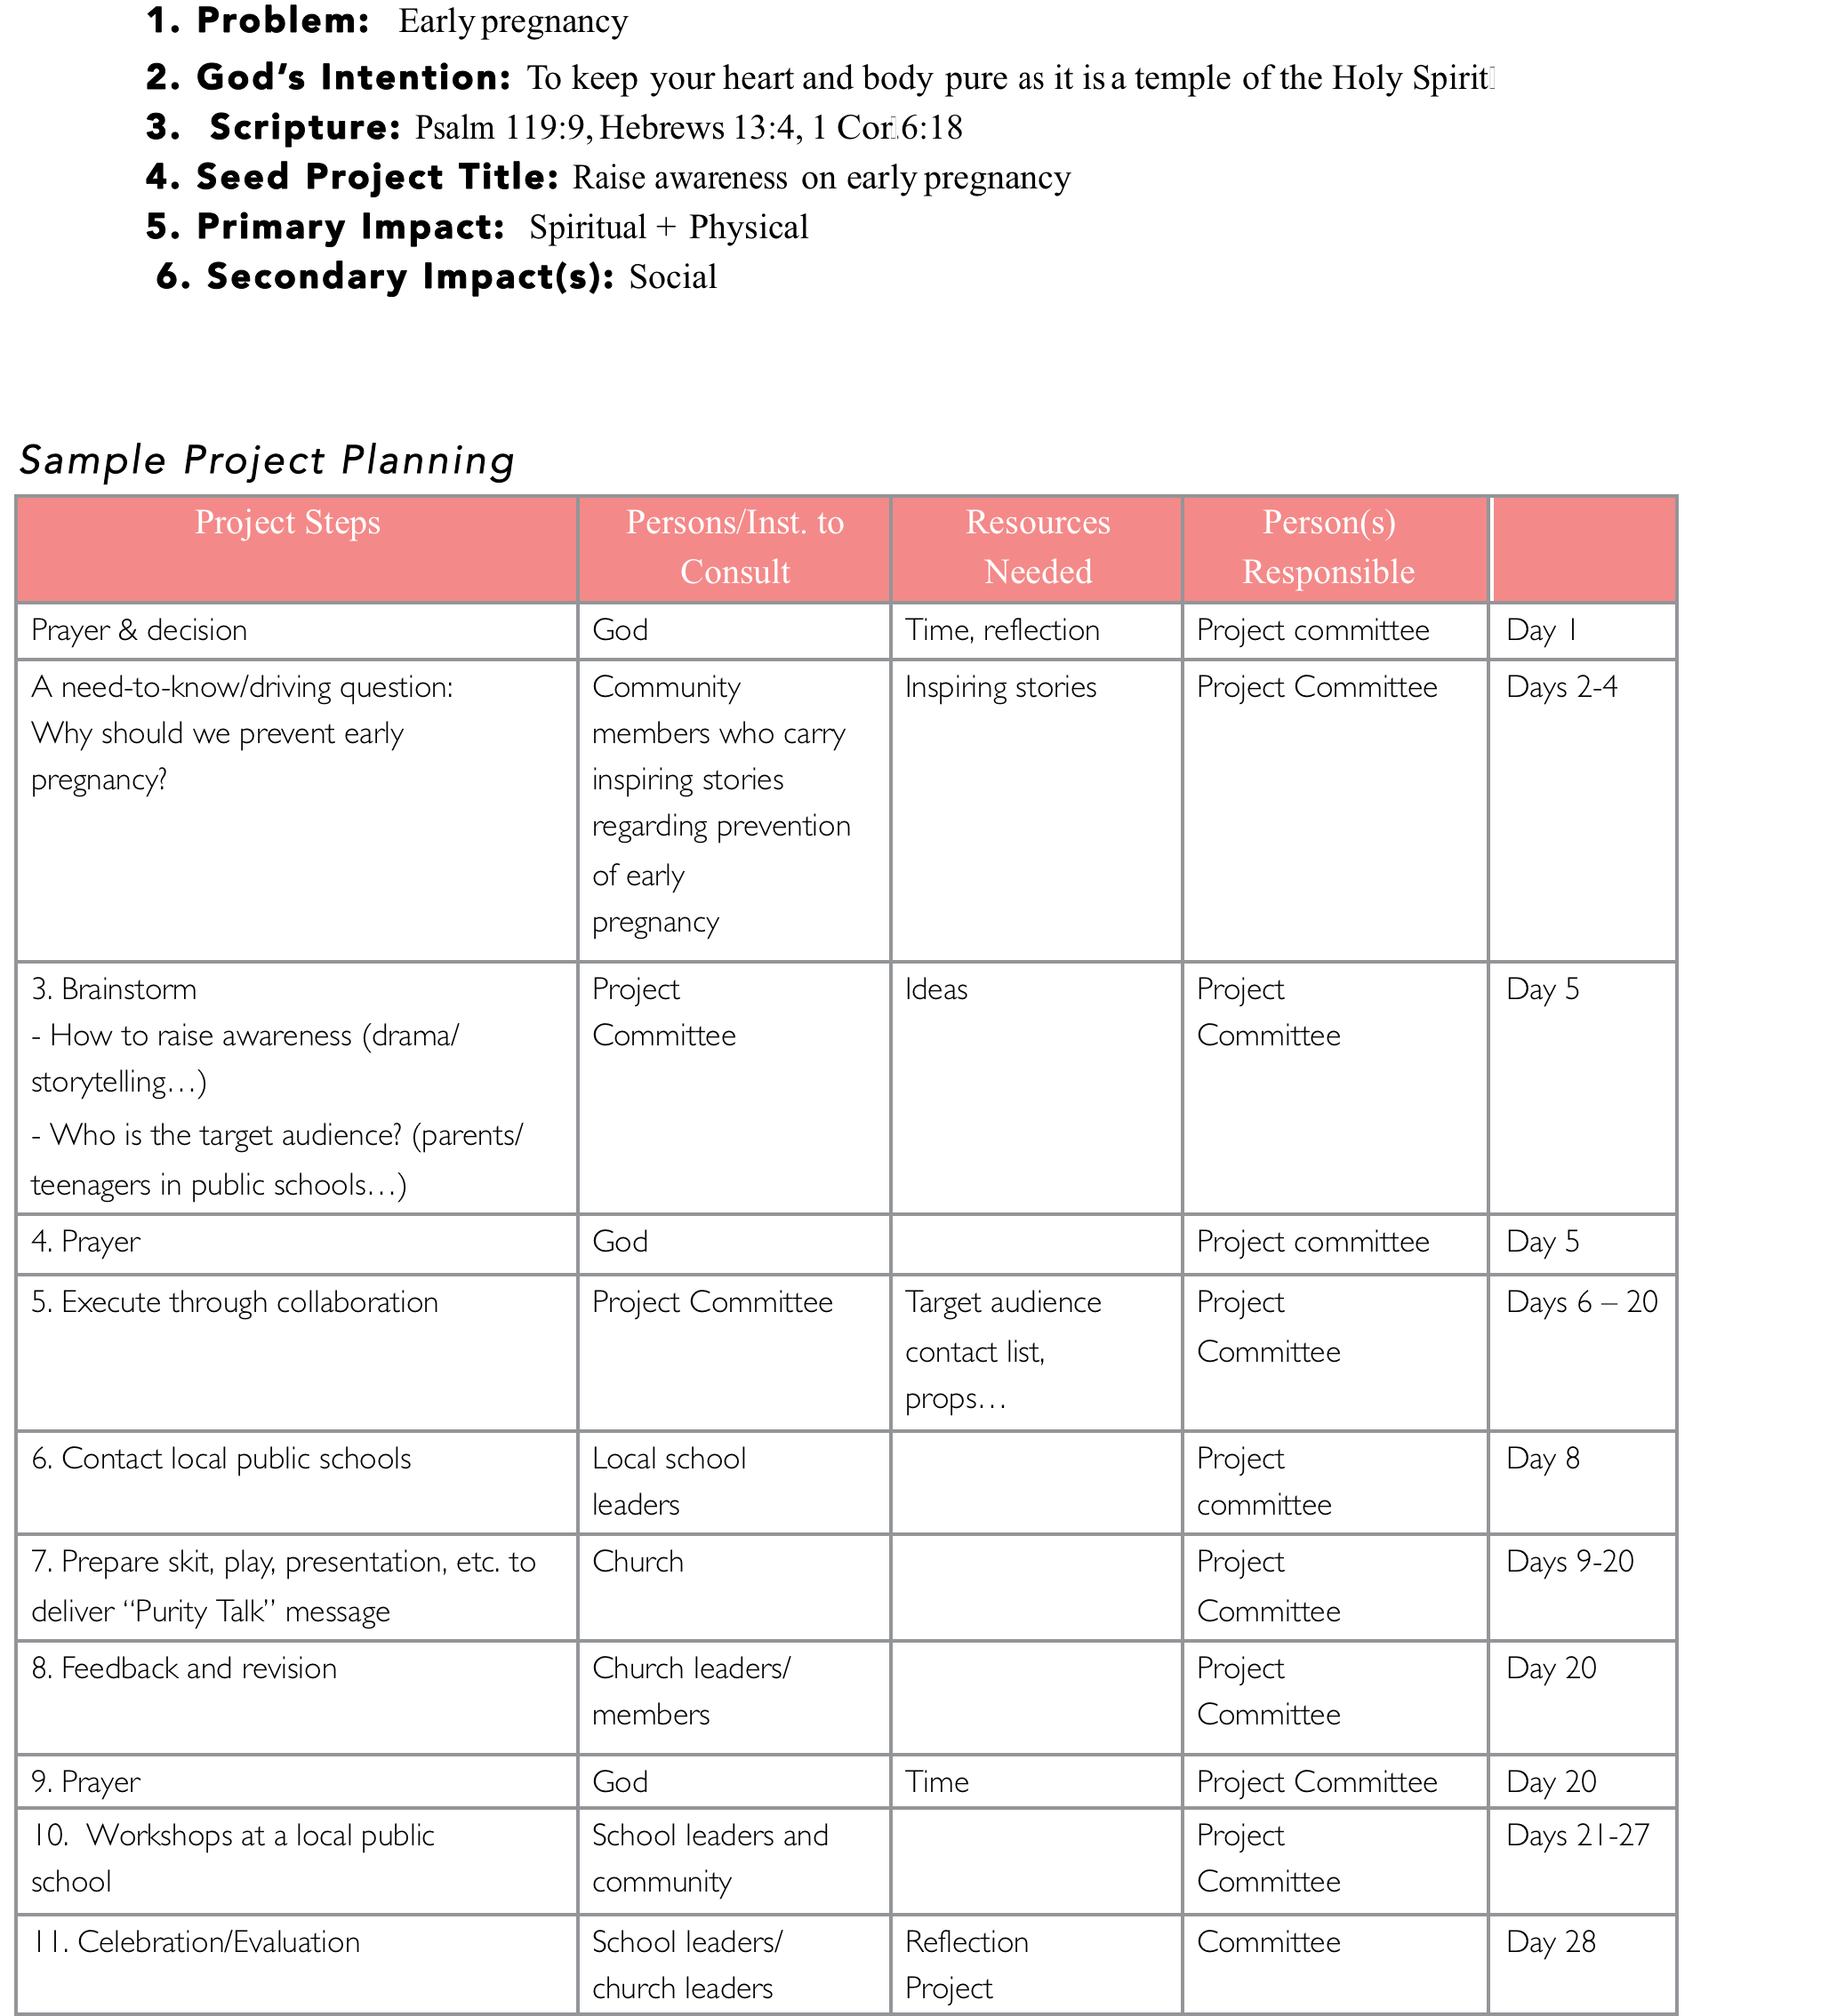

Slide 15
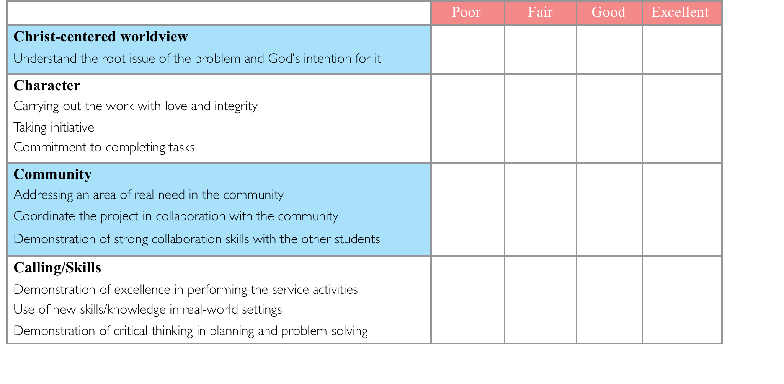

Slide 16
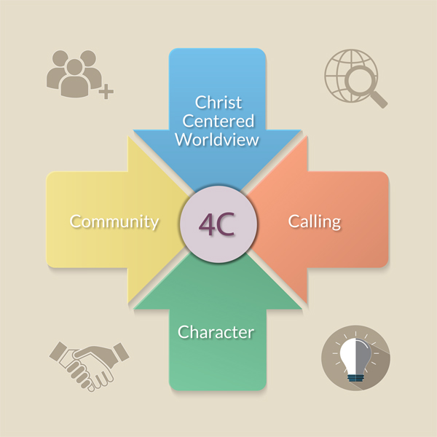

Slide 17
(© image source: http://ctl.utexas.edu/teaching/flipping-a-class/what)

Slide 18
What CaCHE Global does to support our programs…and how we might partner with MATUL
Cultivate the network (learning from related organizations & sharing knowledge across the CaCHE network)
Curriculum development (Adaptation of online curriculum for our local programs)
Facilitator Training (Four-phase model, recruiting the right people, adequate follow-through and communication)
Institutional Partnerships (connecting with potential certifying partners)

Slide 19

Questions for Discussion

